Slide 1


Functions in C Programming
Functions are key components of C programming, making it easy to reuse code and keep things organized. They're like small programs within your larger program, making your code easier to read and fix.
by Istiak Rahman

Slide 2
Types of Functions
Library Functions
User-Defined Functions
These functions are pre-defined and readily available in C libraries. They provide essential functionalities like input/output operations, string manipulation, and mathematical calculations.
These functions are created by programmers to perform specific tasks tailored to their needs. They allow for code organization and modularity, promoting better code reusability and maintainability.
printf()
scanf()
int add(int a, int b) { return a + b; }
strlen()
sqrt()

Slide 3
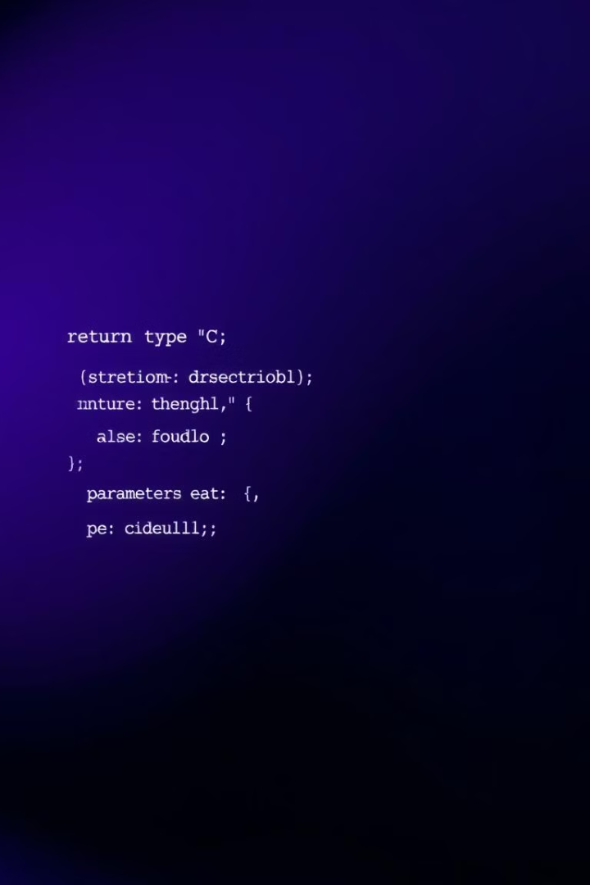
Function Declaration
A function declaration, also called prototyping, tells the compiler about the function's return type, name, and parameters before the function is defined. This helps the compiler check if the function is used correctly in the main program.
int add(int, int);

Slide 4
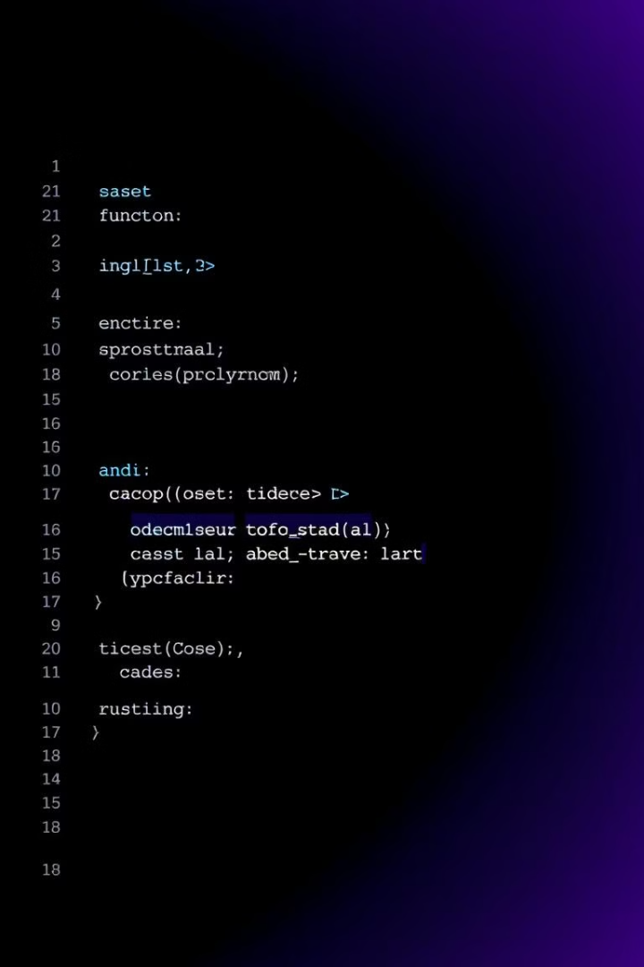
Function Definition
The function definition contains the actual code that executes the function's task. It follows the same syntax as the declaration but includes the function body.
int add(int a, int b) { return a + b; }

Slide 5
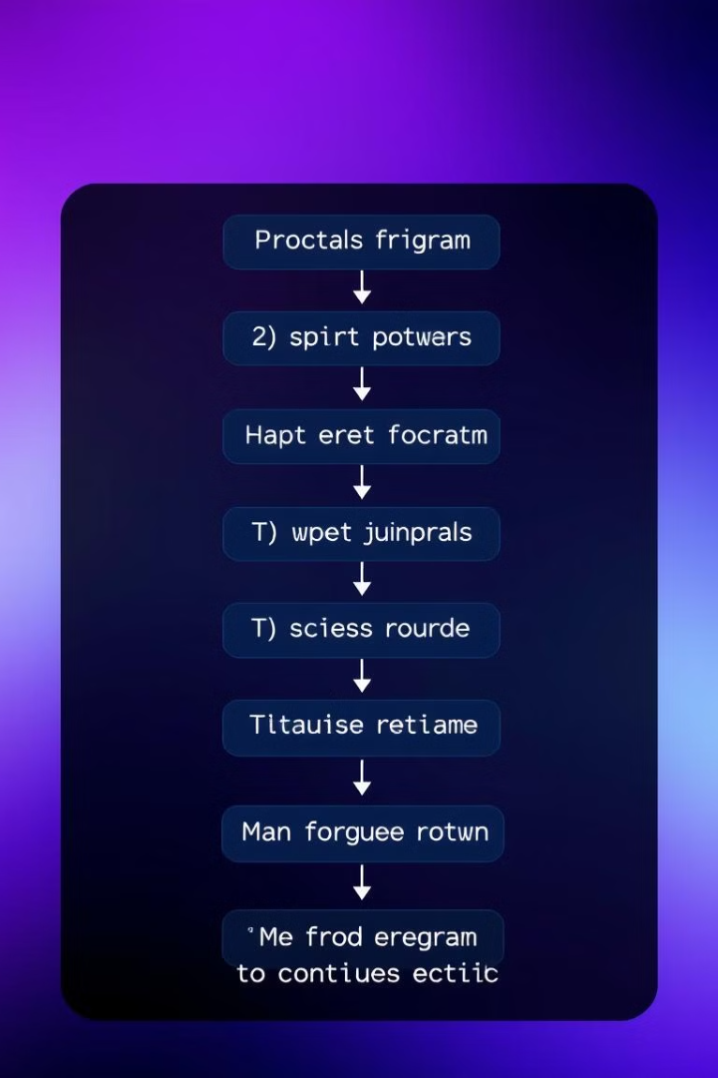
Function Call
Calling a function is how you use it in your program. You pass information to the function (called arguments), and it then runs its code.
int result = add(5, 3);

Slide 6
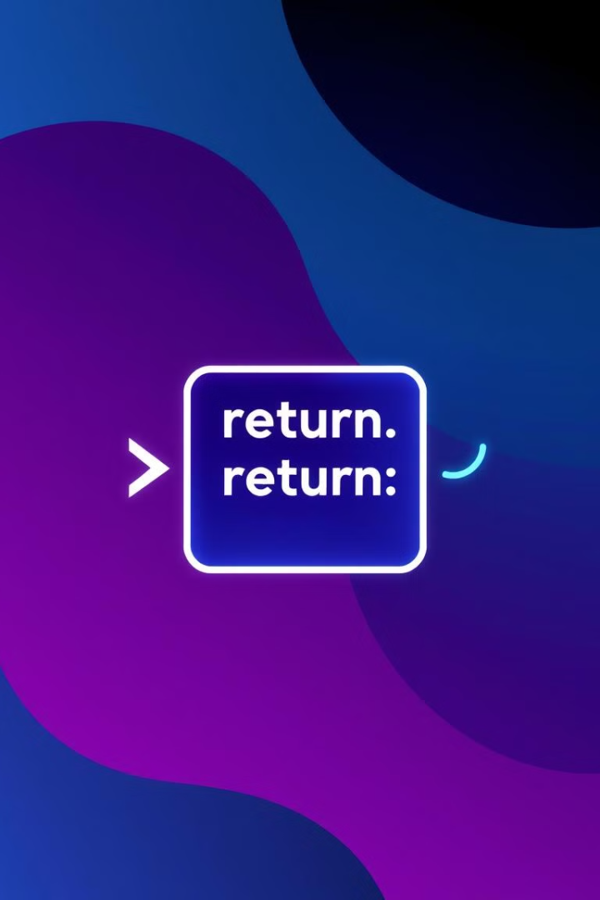
Return Statement
Functions can return a value to the calling code using the return keyword. The return type specifies the data type of the value being returned. If a function doesn't return a value, it is declared with a void return type.
return a + b;

Slide 7
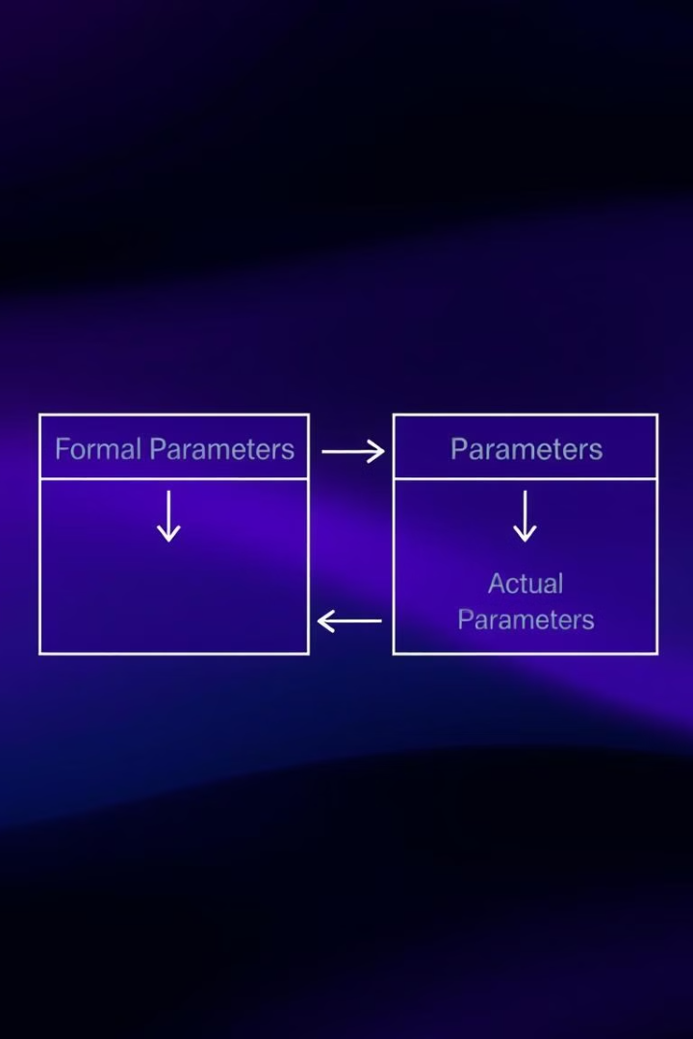
Parameters and Arguments
Parameters are variables declared in the function definition, while arguments are values passed to the function during the call. Parameters act as placeholders for the actual values provided by the arguments.
1
Formal Parameters
Defined in the function definition.
2
Actual Parameters
Passed to the function during the call.

Slide 8
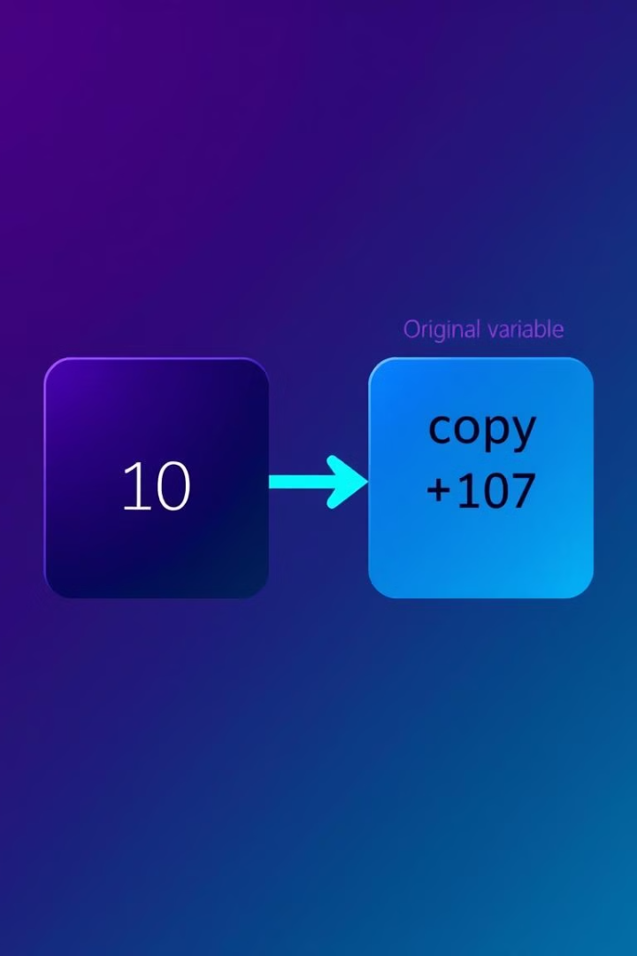
Pass by Value
In pass by value, a copy of the actual value is passed to the function. The function works on this copy, leaving the original variable untouched.
void swap(int x, int y) { int temp = x; x = y; y = temp; }

Slide 9

Thank You!
Presented by: Istiak Rahman
Email: istiak.rahman1020@gmail.com
Thank you for your attention! I appreciate your time and interest.
Keep Learning, Keep Growing

